Slide 1
Chain O’ Lakes Watershed Plan Interactive Project Map Tool

Slide 2
How to finding a project to do or support
Use the link to get to the map
Use map layers to show different types of projects
Use map legend to show project information
Zooming In for project details
Link to Interactive Project Map
https://lakecountyil.maps.arcgis.com/apps/webappviewer/index.html?id=20c7a25b4c844f21b8127637030252c7

Slide 3
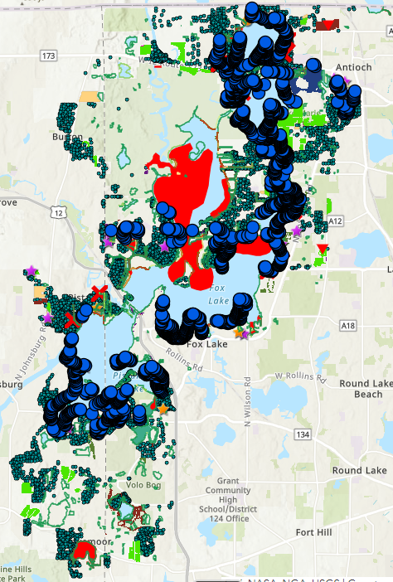
Project Map
All potential projects have been loaded into the Lake County Maps system
You can zoom in to see recommendations for your community, neighborhood or home
https://lakecountyil.maps.arcgis.com/apps/webappviewer/index.html?id=20c7a25b4c844f21b8127637030252c7

Slide 4
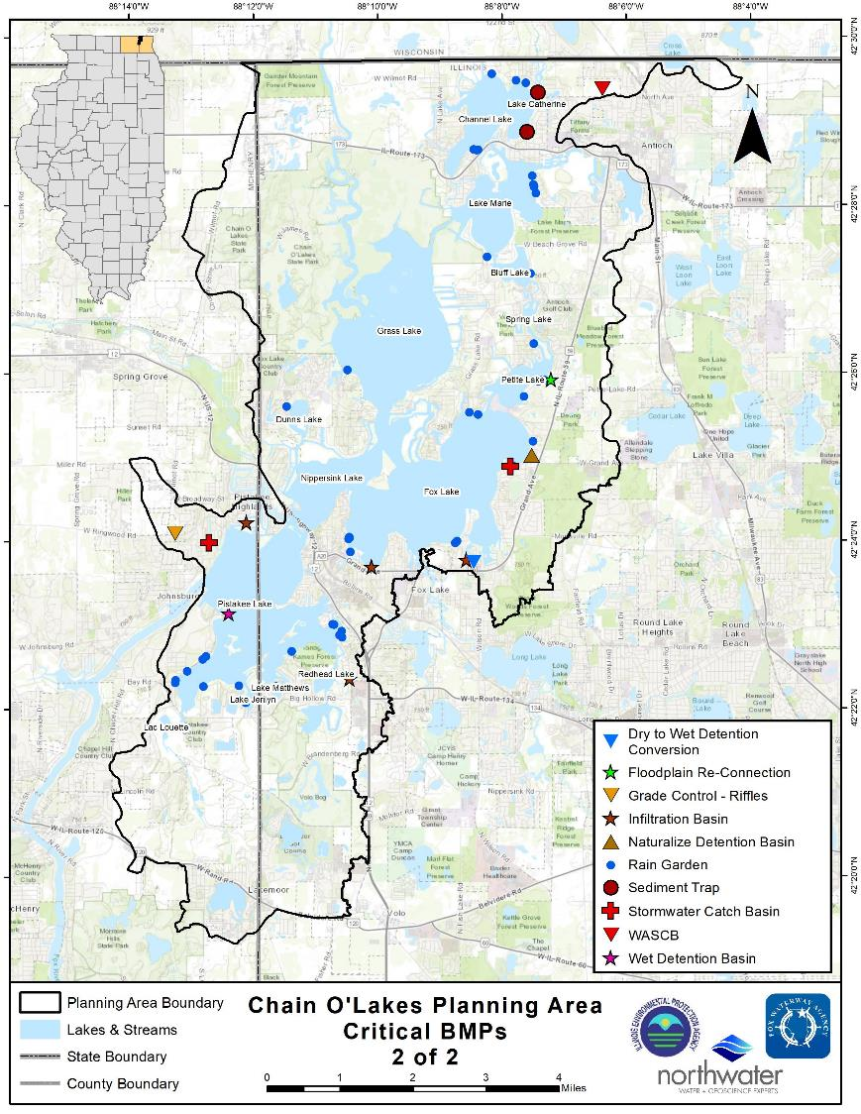
Critical Areas
Site specific projects that will achieve the greatest reduction at the lowest unit cost
294 out of 3,135 recommended
At 15% of the total cost(Excluding dredging and sewer system)
Achieve 61% of total expected nitrogen reduction
45% of the total expected phosphorous reduction
64% of the total expected sediment reduction
46% of the expected bacteria reduction

Slide 5
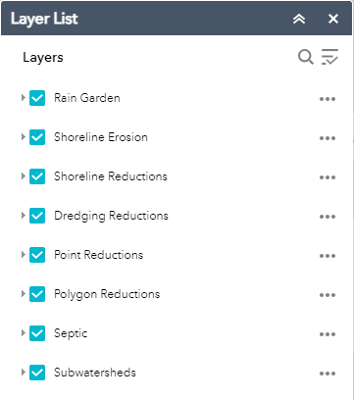
Map Layers
Consider your audience
Type of projects
Location
Select the appropriate layers to shown
Button in the upper right to show layers
Click the blue arrow to turn on and off layers

Slide 6
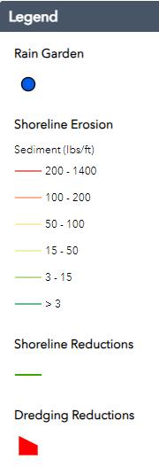
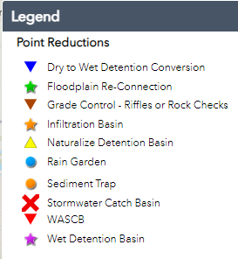
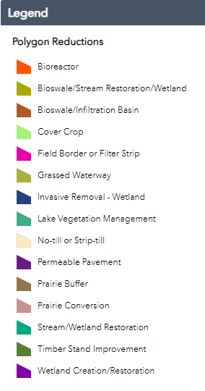
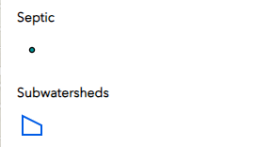
Map Legend
Identifies project types – Button in the upper right of the tool bar

Slide 7
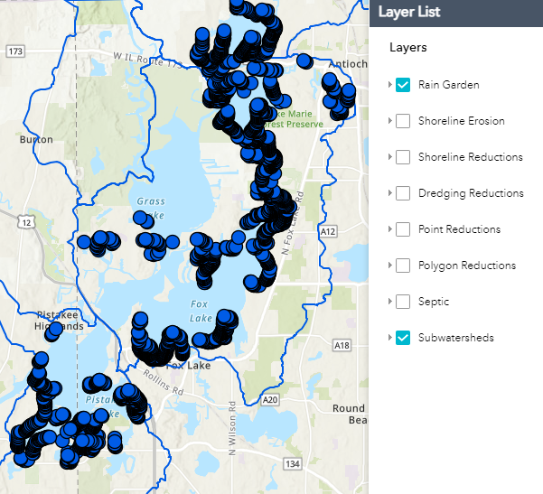
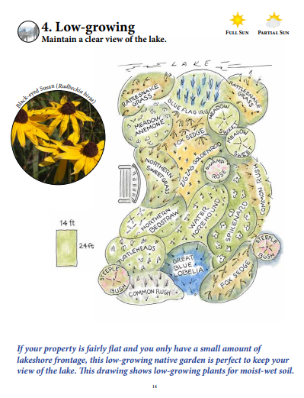
Rain Garden Layer
Target audience – Home owners
All property of suitable size and proximity to the lake to apply a Green Neighborhood Practices
Manage runoff
Disconnecting discharges going directly into the lake
Adding filtering elements such as rain gardens or shoreline buffers
Adding storage such as rain barrels
Use permeable surfaces

Slide 8
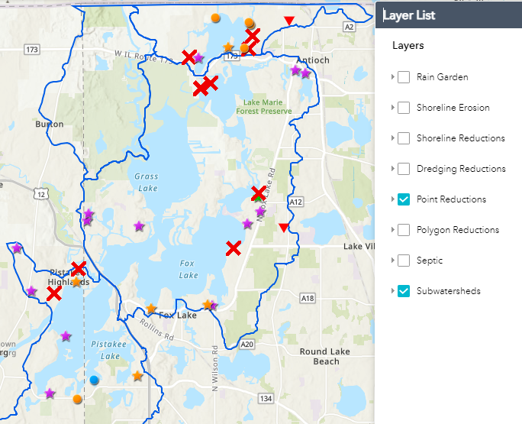
Point Reduction Layer
Target audience
Community Leaders
Larger run off projects

Slide 9
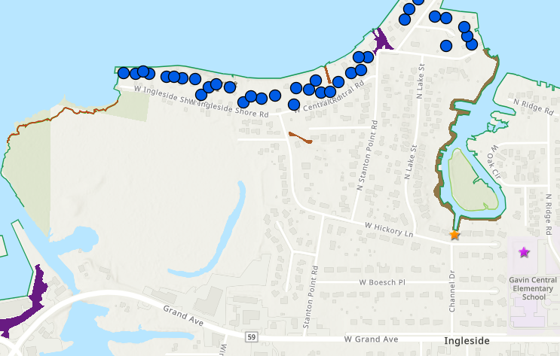
Zoom In
Zoom in on the map to your area of interest

Slide 10
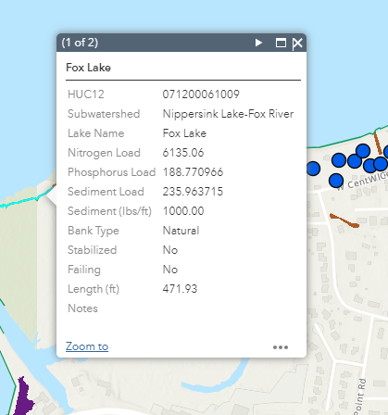
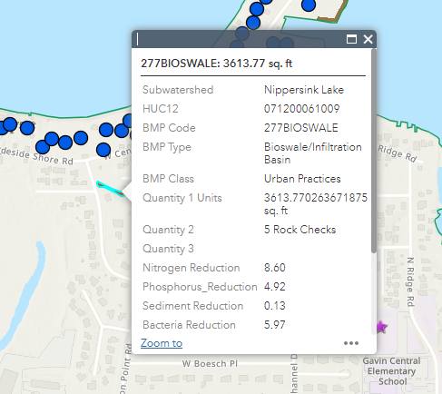
Zoom In
Click on the project to determine type of project, loading impact and estimated cost

Slide 11
Summary
Education
Engagement
Implementation
Improvement
We need the entire community behind the watershed plan
Think of one thing you can do personally
Think of one thing you will be an advocate for
Think of one person you will share information with
Take action
We are here to support you

Slide 12
Questions?

Slide 13
Thank you for support the Chain O’ Lake Watershed Plan
To find out more check out the
Executive Summary
on the Fox Waterway Agency webpage
https://foxwaterway.com/wp-content/uploads/Executive-Summary-COLWBP-3-2024-FINAL.pdf

